Slide 1
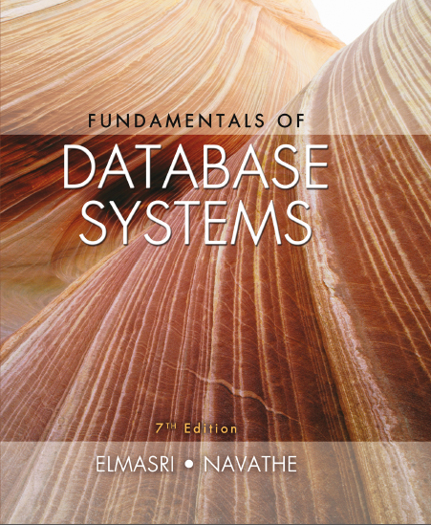
Fundamentals of Database Systems
Seventh Edition
Chapter 23
Distributed Database Concepts
Copyright © 2016, 2011, 2007 Pearson Education, Inc. All Rights Reserved
Notes:
If this PowerPoint presentation contains mathematical equations, you may need to check that your computer has the following installed:
1) MathType Plugin
2) Math Player (free versions available)
3) NVDA Reader (free versions available)

Slide 2
Introduction
Distributed computing system
Consists of several processing sites or nodes interconnected by a computer network
Nodes cooperate in performing certain tasks
Partitions large task into smaller tasks for efficient solving
Big data technologies
Combine distributed and database technologies
Deal with mining vast amounts of data

Slide 3
23.1 Distributed Database Concepts (1 of 2)
What constitutes a distributed database?
Connection of database nodes over computer network
Logical interrelation of the connected databases
Possible absence of homogeneity among connected nodes
Distributed database management system (D D B M S)
Software system that manages a distributed database

Slide 4
Distributed Database Concepts (2 of 2)
Local area network
Hubs or cables connect sites
Long-haul or wide area network
Telephone lines, cables, wireless, or satellite connections
Network topology defines communication path
Transparency
Hiding implementation details from the end user

Slide 5
Transparency
Types of transparency
Data organization transparency
Location transparency
Naming transparency
Replication transparency
Fragmentation transparency
Horizontal fragmentation
Vertical fragmentation
Design transparency
Execution transparency

Slide 6
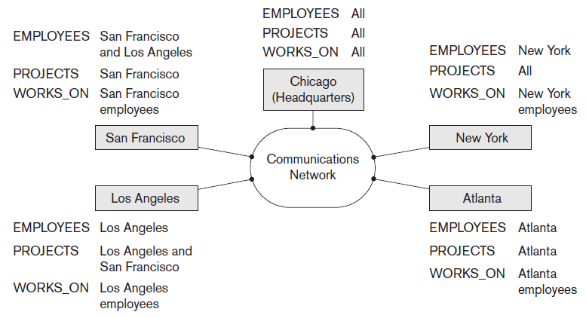
Distributed Databases
Figure 23.1 Data distribution and replication among distributed databases

Slide 7
Availability and Reliability
Availability
Probability that the system is continuously available during a time interval
Reliability
Probability that the system is running (not down) at a certain time point
Both directly related to faults, errors, and failures
Fault-tolerant approaches

Slide 8
Scalability and Partition Tolerance
Horizontal scalability
Expanding the number of nodes in a distributed system
Vertical scalability
Expanding capacity of the individual nodes
Partition tolerance
System should have the capacity to continue operating while the network is partitioned

Slide 9
Autonomy
Determines extent to which individual nodes can operate independently
Design autonomy
Independence of data model usage and transaction management techniques among nodes
Communication autonomy
Determines the extent to which each node can decide on sharing information with other nodes
Execution autonomy
Independence of users to act as they please

Slide 10
Advantages of Distributed Databases
Improved ease and flexibility of application development
Development at geographically dispersed sites
Increased availability
Isolate faults to their site of origin
Improved performance
Data localization
Easier expansion via scalability
Easier than in non-distributed systems

Slide 11
23.2 Data Fragmentation, Replication, and Allocation Techniques for Distributed Database Design
Fragments
Logical units of the database
Horizontal fragmentation (sharding)
Horizontal fragment or shard of a relation is a subset of the tuples in that relation
Can be specified by condition on one or more attributes or by some other method
Groups rows to create subsets of tuples
Each subset has a certain logical meaning

Slide 12
Data Fragmentation (1 of 2)
Vertical fragmentation
Divides a relation vertically by columns
Keeps only certain attributes of the relation
Complete horizontal fragmentation
Apply UNION operation to the fragments to reconstruct relation
Complete vertical fragmentation
Apply OUTER UNION or FULL OUTER JOIN operation to reconstruct relation

Slide 13
Data Fragmentation (2 of 2)
Mixed (hybrid) fragmentation
Combination of horizontal and vertical fragmentations
Fragmentation schema
Defines a set of fragments that includes all attributes and tuples in the database
Allocation schema
Describes the allocation of fragments to nodes of the D D B S

Slide 14
Data Replication and Allocation (1 of 2)
Fully replicated distributed database
Replication of whole database at every site in distributed system
Improves availability remarkably
Update operations can be slow
Nonredundant allocation (no replication)
Each fragment is stored at exactly one site

Slide 15
Data Replication and Allocation (2 of 2)
Partial replication
Some fragments are replicated and others are not
Defined by replication schema
Data allocation (data distribution)
Each fragment assigned to a particular site in the distributed system
Choices depend on performance and availability goals of the system

Slide 16
Example of Fragmentation, Allocation, and Replication
Company with three computer sites
One for each department
Expect frequent access by employees working in the department and projects controlled by that department
See Figures 23.2 and 23.3 in the text for example fragmentation among the three sites

Slide 17
23.3 Overview of Concurrency Control and Recovery in Distributed Databases
Problems specific to distributed D B M S environment
Multiple copies of the data items
Failure of individual sites
Failure of communication links
Distributed commit
Distributed deadlock

Slide 18
Distributed Concurrency Control Based on a Distinguished Copy of a Data Item
Particular copy of each data item designated as distinguished copy
Locks are associated with the distinguished copy
Primary site technique
All distinguished copies kept at the same site
Primary site with backup site
Locking information maintained at both sites
Primary copy method
Distributes the load of lock coordination among various sites

Slide 19
Distributed Concurrency Control Based on Voting
Voting method
No distinguished copy
Lock requests sent to all sites that contain a copy
Each copy maintains its own lock
If transaction that requests a lock is granted that lock by a majority of the copies, it holds the lock on all copies
Time-out period applies
Results in higher message traffic among sites

Slide 20
Distributed Recovery
Difficult to determine whether a site is down without exchanging numerous messages with other sites
Distributed commit
When a transaction is updating data at several sties, it cannot commit until certain its effect on every site cannot be lost
Two-phase commit protocol often used to ensure correctness

Slide 21
23.4 Overview of Transaction Management in Distributed Databases
Global transaction manager
Supports distributed transactions
Role temporarily assumed by site at which transaction originated
Coordinates execution with transaction managers at multiple sites
Passes database operations and associated information to the concurrency controller
Controller responsible for acquisition and release of locks

Slide 22
Commit Protocols
Two-phase
Coordinator maintains information needed for recovery
In addition to local recovery managers
Three-phase
Divides second commit phase into two subphases
Prepare-to-commit phase communicates result of the vote phase
Commit subphase same as two-phase commit counterpart

Slide 23
23.5 Query Processing and Optimization in Distributed Databases (1 of 4)
Stages of a distributed database query
Query mapping
Refers to global conceptual schema
Localization
Maps the distributed query to separate queries on individual fragments
Global query optimization
Strategy selected from list of candidates
Local query optimization
Common to all sites in the D D B

Slide 24
Query Processing and Optimization in Distributed Databases (2 of 4)
Data transfer costs of distributed query processing
Cost of transferring intermediate and final result files
Optimization criterion: reducing amount of data transfer

Slide 25
Query Processing and Optimization in Distributed Databases (3 of 4)
Distributed query processing using semijoin
Reduces the number of tuples in a relation before transferring it to another site
Send the joining column of one relation R to one site where the other relation S is located
Join attributes and result attributes shipped back to original site
Efficient solution to minimizing data transfer

Slide 26
Query Processing and Optimization in Distributed Databases (4 of 4)
Query and update decomposition
User can specify a query as if the D B M S were centralized
If full distribution, fragmentation, and replication transparency are supported
Query decomposition module
Breaks up a query into subqueries that can be executed at the individual sites
Strategy for combining results must be generated
Catalog stores attribute list and/or guard condition

Slide 27
23.6 Types of Distributed Database Systems (1 of 4)
Factors that influence types of D D B M S
Degree of homogeneity of D D B M S software
Homogeneous
Heterogeneous
Degree of local autonomy
No local autonomy
Multidatabase system has full local autonomy
Federated database system (F D B S)
Global view or schema of the federation of databases is shared by the applications

Slide 28
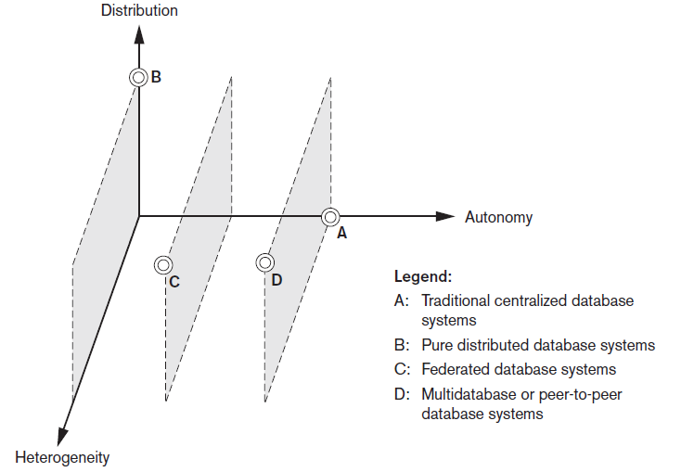
Classification of Distributed Databases
Figure 23.6 Classification of distributed databases

Slide 29
Types of Distributed Database Systems (2 of 4)
Federated database management systems issues
Differences in data models
Differences in constraints
Differences in query languages
Semantic heterogeneity
Differences in meaning, interpretation, and intended use of the same or related data

Slide 30
Types of Distributed Database Systems (3 of 4)
Design autonomy allows definition of the following parameters
The universe of discourse from which the data is drawn
Representation and naming
Understanding, meaning, and subjective interpretation of data
Transaction and policy constraints
Derivation of summaries

Slide 31
Types of Distributed Database Systems (4 of 4)
Communication autonomy
Decide whether to communicate with another component D B S
Execution autonomy
Execute local operations without interference from external operations by other component D B S
Ability to decide order of execution
Association autonomy
Decide whether and how much to share its functionality and resources

Slide 32
23.7 Distributed Database Architectures
Parallel versus distributed architectures
Types of multiprocessor system architectures
Shared memory (tightly coupled)
Shared disk (loosely coupled)
Shared-nothing

Slide 33
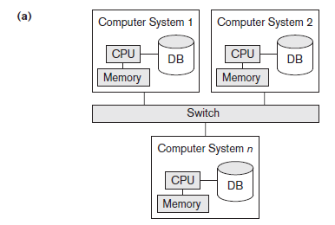
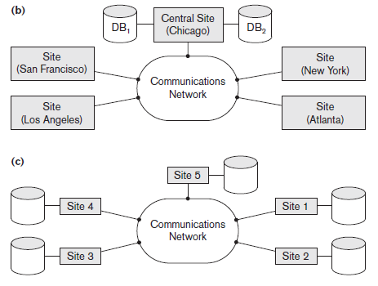
Database System Architectures
Figure 23.7 Some different database system architectures (a) Shared-nothing architecture (b) A networked architecture with a centralized database at one of the sites (c) A truly distributed database architecture

Slide 34
General Architecture of Pure Distributed Databases
Global query compiler
References global conceptual schema from the global system catalog to verify and impose defined constraints
Global query optimizer
Generates optimized local queries from global queries
Global transaction manager
Coordinates the execution across multiple sites with the local transaction managers

Slide 35
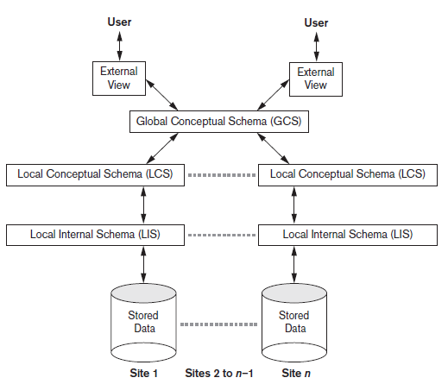
Schema Architecture of Distributed Databases
Figure 23.8 Schema architecture of distributed databases

Slide 36
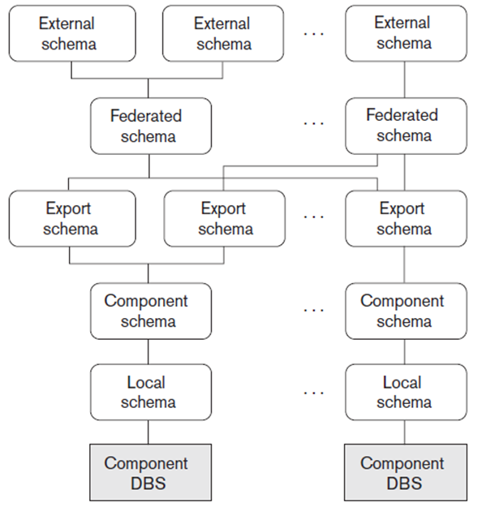
Federated Database Schema Architecture
Figure 23.9 The five-level schema architecture in a federated database system (F D B S)

Slide 37
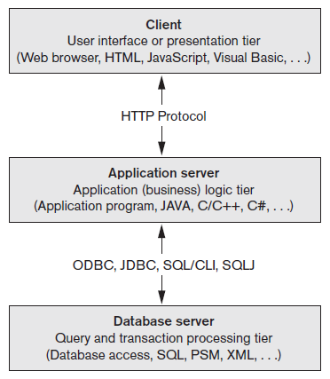
An Overview of Three-Tier Client/Server Architecture
Division of D B M S functionality among the three tiers can vary
Figure 23.10 The three-tier client/server architecture

Slide 38
23.8 Distributed Catalog Management
Centralized catalogs
Entire catalog is stored at one single site
Easy to implement
Fully replicated catalogs
Identical copies of the complete catalog are present at each site
Results in faster reads
Partially replicated catalogs
Each site maintains complete catalog information on data stored locally at that site

Slide 39
23.9 Summary
Distributed database concept
Distribution transparency
Fragmentation transparency
Replication transparency
Design issues
Horizontal and vertical fragmentation
Concurrency control and recovery techniques
Query processing
Categorization of D D B M S s

Slide 40

Copyright

